Slide 1
Machine Learning
In a nutshell
Marcel van Velzen
Junior Marte Garcia

Slide 2
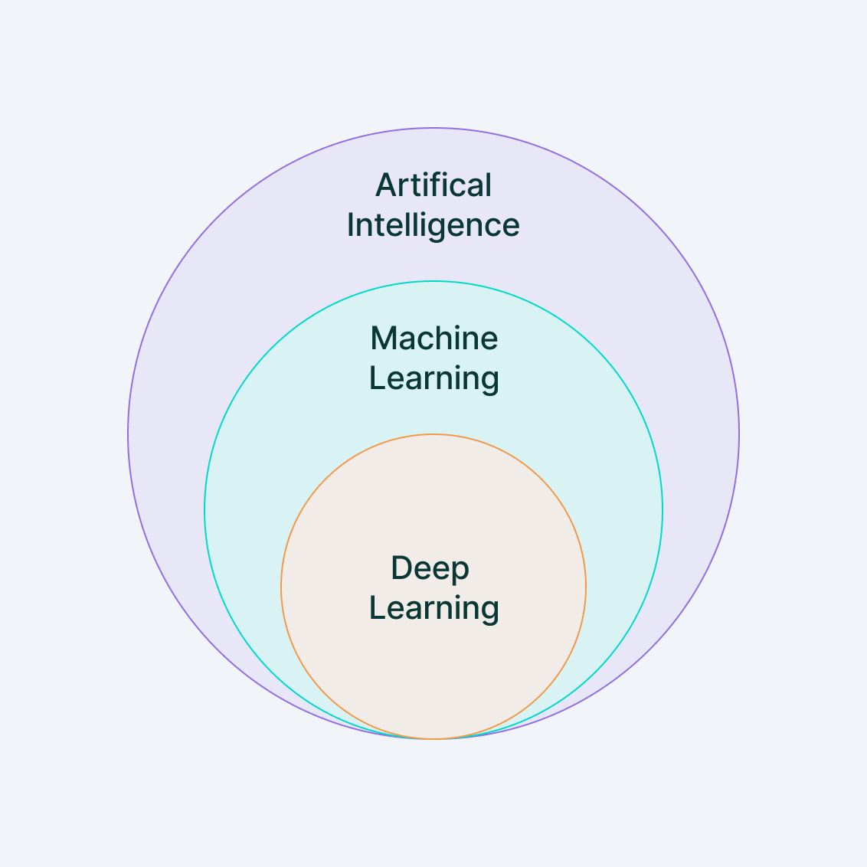
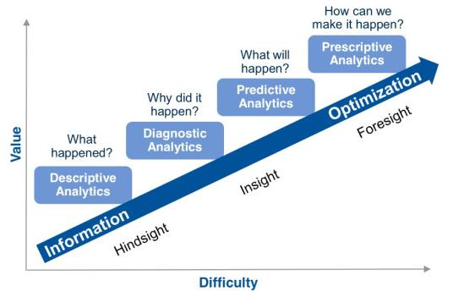
Definition
Machine learning is a branch of artificial intelligence (AI) and computer science which focuses on the use of data and algorithms to imitate the way that humans learn, gradually improving its accuracy.

Slide 3
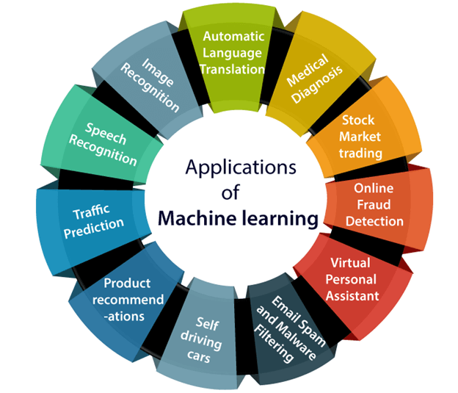
Applications

Slide 4

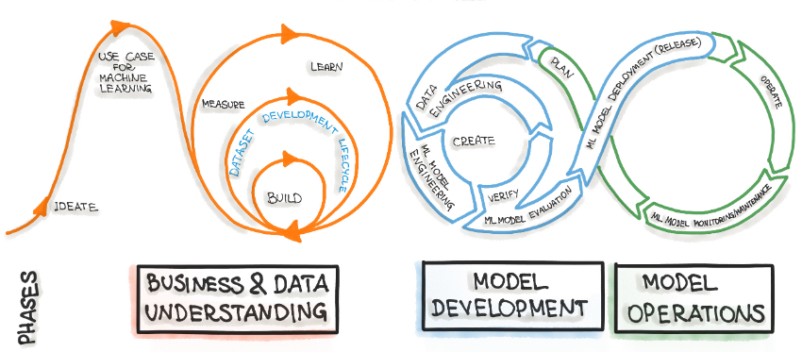
CRISP-ML(Q)

Slide 5
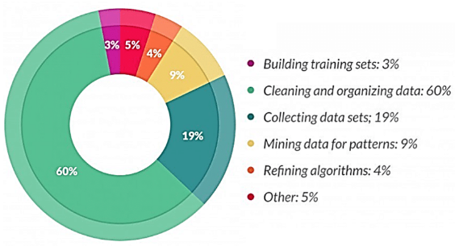
Tasks
Data duplication – removal of duplicated observations
Dimensionality reduction – find projection that captures observations
Encoding – transform data so that it can be consumed by the modeling methods
Missing data – delete, estimate, ignore and replace observations
Noise reduction – remove unwanted or clean up polluted observations
Outliers – identifying observations that do not fit the others
Feature selection – remove redundant or irrelevant attributes
Sampling – find a representative subset
Transformation – map attribute values/objects into a single attribute value/object

Slide 6
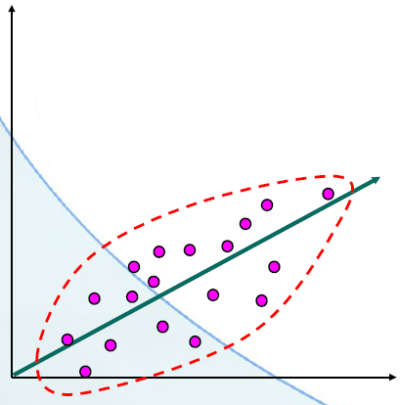
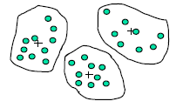
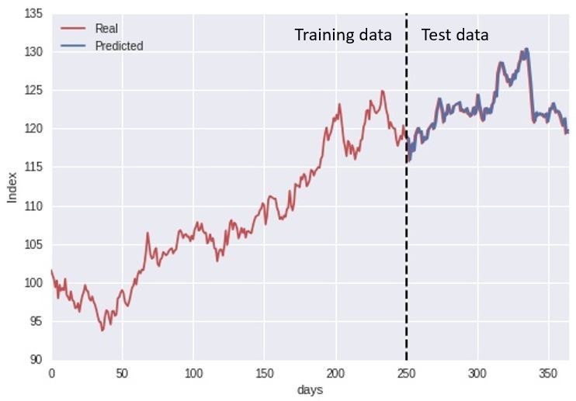
Supervised Learning
Regression – assessing the relationship between traits
in the data and calculates how much a variable changes
when any other variables change
Classification – identify new occurrences
which category it belongs to based on known
observations
Time series – predicting future values based on historical data

Slide 7
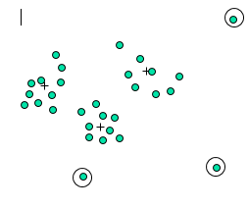

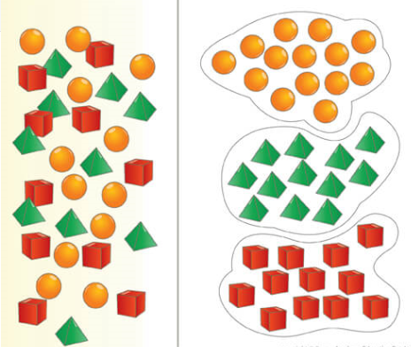


Unsupervised Learning
Outlier detection – detecting occurrences which
fall outside the norm
Association rules – searching and identifying
dependencies, relationships or orders between
features in the data
Clustering – grouping occurrences which have common properties
Sentiment analysis – measuring of the sentiment
Dimensionality reduction – compresses the data that encapsulates the original data

Slide 8
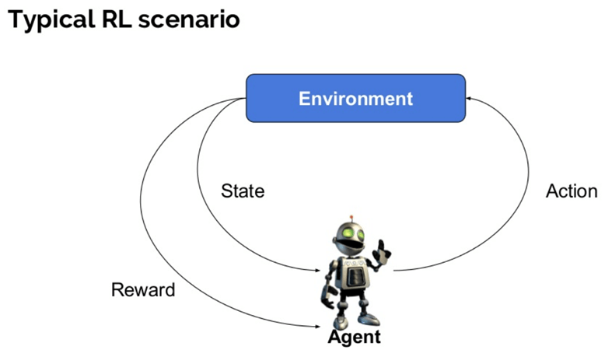
Reinforcement Learning
Model-free
Model-based
Policy Optimization
Q-Learning
Learn the Model
Given the Model

Slide 9
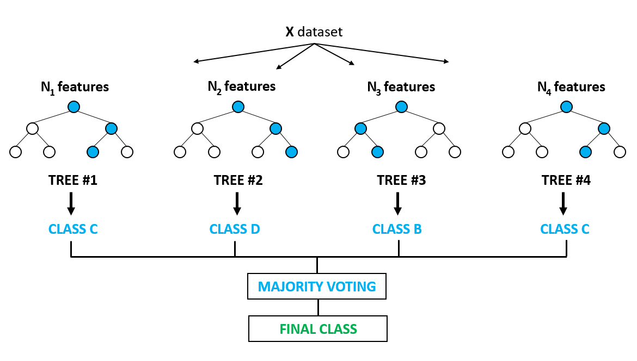
Random Forest
Random Forest combines the output of multiple decision trees to reach a single result to make predictions or classify data
Benefits | Drawbacks
Versatile and easy to use | Computationally demanding
Handles high-dimensional spaces | Model interpretability
Feature importance | Overcomplexity
Robust to overfitting | Bias in multiclass problems
Out-of-box predictor | Lack of precision

Slide 10
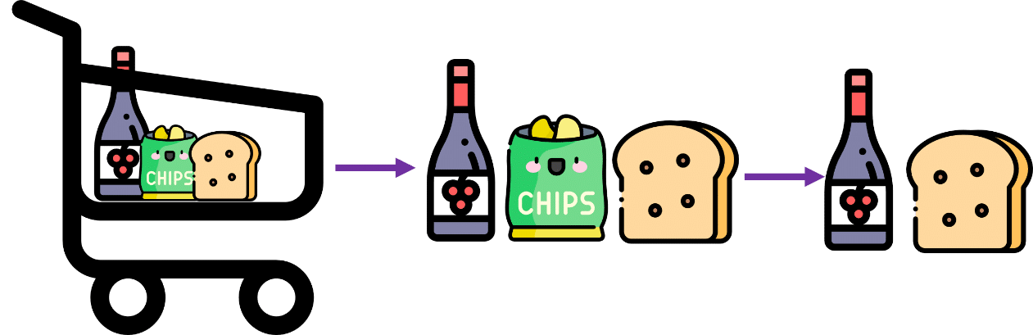
Apriori algorithm
The Apriori algorithm finds frequent patterns and associations in a transactional dataset
Benefits | Drawbacks
Simplicity and ease of implementation | Computational complexity
The rules are human-readable | Difficulty handling sparse data
Flexible and customisable | Limited discovery of complex patterns
The algorithm is widely used and studied | Bias of minimum support threshold
 | Inability to handle numeric data

Slide 11
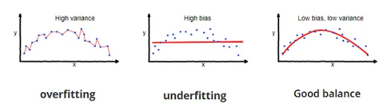
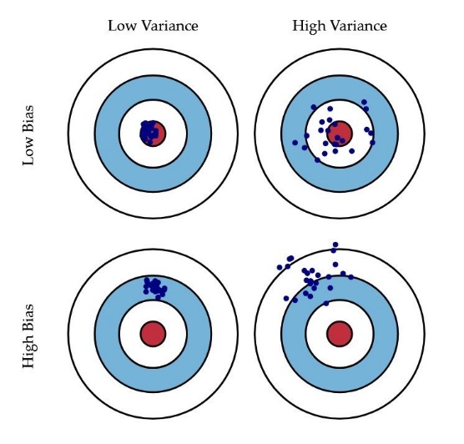
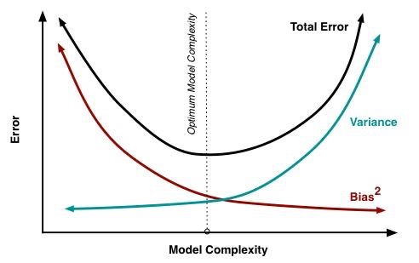
Bias-Variance Tradeoff
There is a tradeoff between a model's ability to minimize bias and variance

Slide 12
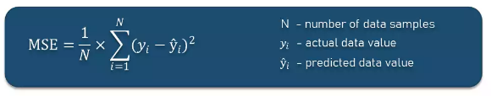
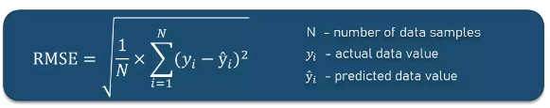
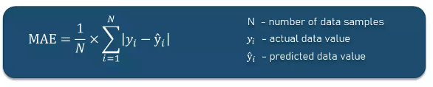
Regression Metrics

Slide 13
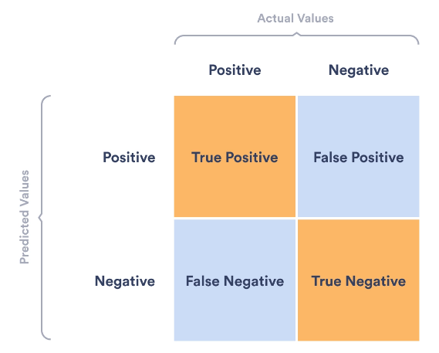
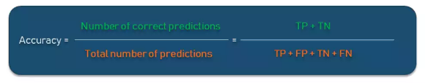
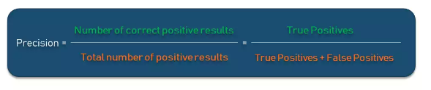
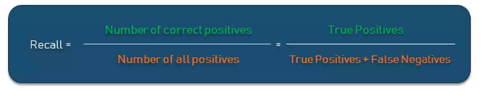
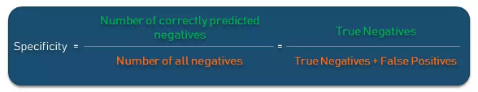
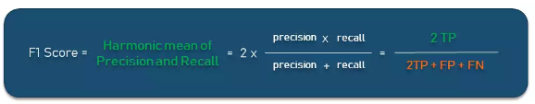
Classification Metrics
A confusion matrix visualizes and summarizes the performance of a classification algorithm

Slide 14
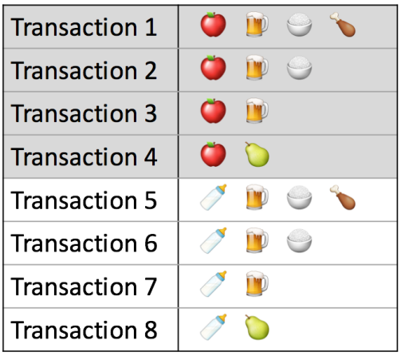



Associations Metrics
This says how popular an itemset is, as measured by the proportion of transactions in which an itemset appears
The support of {apple} is 4 out of 8, or 50%
This says how likely item Y is purchased when item X is purchased, expressed as {X -> Y}
The confidence of {apple -> beer} is 3 out of 4, or 75%
This says how likely item Y is purchased when item X is purchased, while controlling for how popular item Y is
The lift of {apple -> beer} is 3 out of 4 multiplied by 6, or 12,5%

